Slide 1

Winzo Case Study
Subhadip Samanta
IIFT Delhi

Slide 2
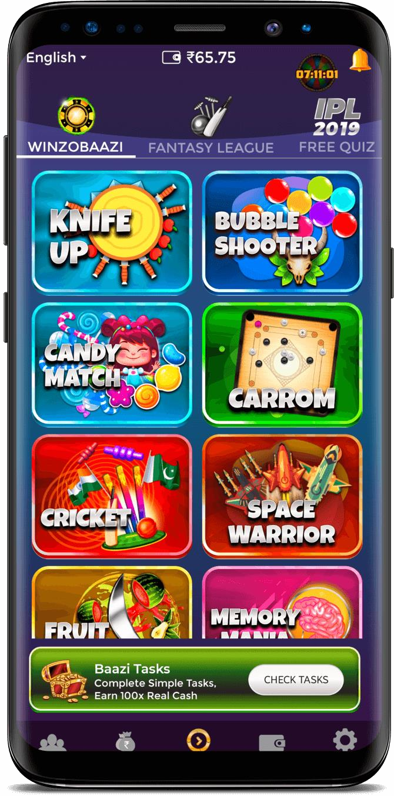




ABOUT WINZO:
Launched in early 2018, WINZO is available in 12 languages with over 25 million registered users. Clocking over 1 billion micro-transactions per month, the company offers over 70 games across various multiplayer formats and focuses on building a community of gamers and game influencers in tier II–tier V cities of India. It has grown by 1,500 per cent and has acquired over 20 million users in the past 12 months.
WinZo has recently raised USD 18 million in Series B funding round led by Singapore- based Makers Fund and New York’s Courtside Ventures.
OUR GOAL:
Our goal is to define “New User”, “Power Users” and “Churned Users” for
WinZo and converting New Users & Churned Users to Power Users with the help of product solutions.

Slide 3




USER PERSONAS:
20 years old Varun is a second years B.E. student.
Lives in collage hostel and is a crazy “Call of Duty” player.
Plays more than 3 to 4 hours daily.
26 years old Parul is a software developer in TCS.
Lives with her aunt and likes to play carrom in her free time.
Plays 2 to 3 games weekly.
18 years old Sunny is Varun’s cousin and has just got free from 12th boards.
Sunny has recently
downloaded WinZo by getting referred from his cousin Varun.
POWER USER
CHURNED USER
NEW USER

Slide 4
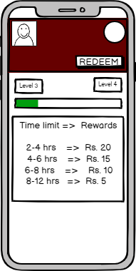
SOLUTION 1: LEVEL UP BONUS WITHIN TIME LIMIT
Feature – There will be special rewards for users if they complete their current level within a given time frames, less time they take to complete, more will be the reward.
Insights – This feature will increase likelihood of a user to play for a longer period and coming back to the app more frequently to complete the challenge within the time limits.
User value proposition – In current scenario a small amount of Rs. 2 is awarded during level up, this can be increased to a higher amount within time frames, which will lead to higher time spent on app by the user to get more rewards.
Metrics to Consider -
DAU/MAU
No. of times app opened in a day
Avg. time spent on the app
Retention Rate

Slide 5
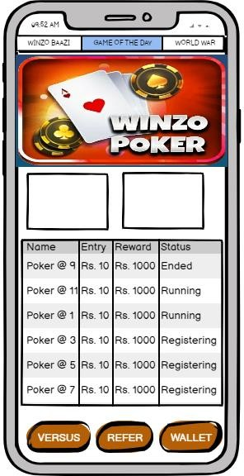
SOLUTION 2: GAME OF THE DAY
Feature – Based on the most played game ‘or’ most trending game on app, game of the week will be decided, where on weekends the most played game will be present. Every 2 hours there will be a tournament of that game with high rewards.
Insights – This feature will increase the probability of user to return on app whenever is his favorite game of the day , and win higher rewards participating in tournaments.
User value proposition – This will be a featured product with banners on the home screen saying highest rewards on the app can be won with the help of ‘Game of the day’. It will be a knockout tournament with the final 20 players getting rewards, something like tourney in poker.
Metrics to Consider -
DAU/MAU
No. of times app opened in a day
Avg. time spent on the app

Slide 6
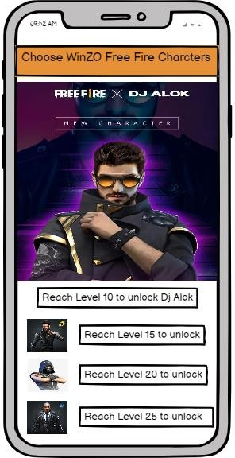
SOLUTION 3: SPECIAL WINZO GAME CHARACTERS/SKINS/GUNS
Feature – There will be special WinZo game characters, skins, guns when the users will play from the WinZo app.
Insights – This feature will increase the user base for WinZo as a lot of games are played for their special characters, maps, skins, guns, cars etc. User will also return regularly on the app to check the latest characters offered to them.
User value proposition – Users love to have special game characters, so while collaborating with the games we can ask for special WinZo characters which will lead to higher user acquisition and retention in return which will lead to more time spend on the app.
Metrics to Consider -
Month on month users
DAU/MAU
No. of times app opened in a week/month
Avg. time spent on the app

Slide 7
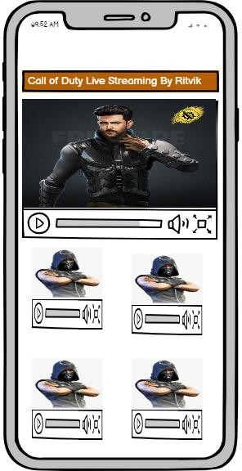
SOLUTION 4: LIVE STREAMING OF GAMES BY INFLUENCERS ON WINZO TV
Feature – This will be a new engaging feature where in the top 5 players of the month or the top influencers will be allowed to go live from the app while they play.
Insights – This feature will increase the engagement and time spent on the game by players to come in top 5 so that they get a chance to get featured on the WinZo TV platform.
User value proposition – Everyone loves to get featured on some platform or becoming the next influencer. This feature will help the players to achieve popularity.
Metrics to Consider -
Watched content
DAU/MAU
Avg. time spent on the app

Slide 8



